Slide 1
TASK-2
Prepare a dataset
Train a machine learning model
Evaluate and present your findings

Slide 2
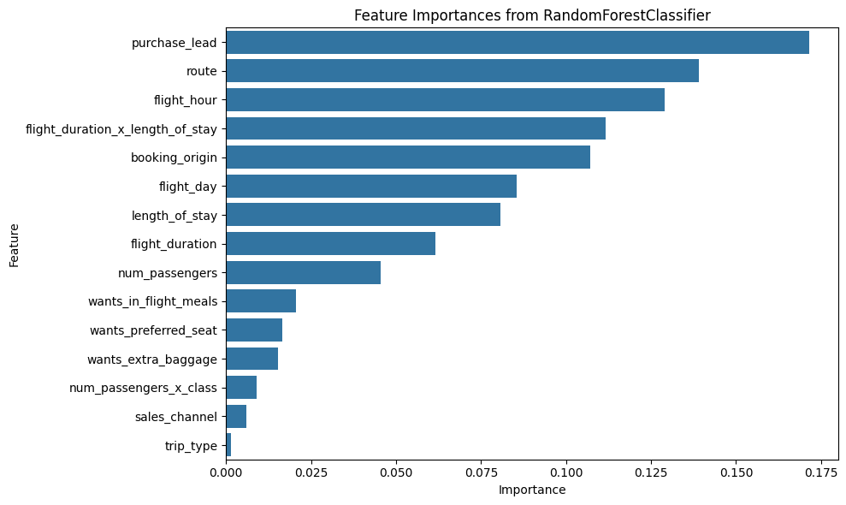
Internet bookings had a higher completion rate than mobile, with RoundTrip bookings outperforming OneWay and CircleTrip. Longer flights showed lower completion rates, indicating a negative correlation with flight duration. Most bookings were made online, with RoundTrip as the preferred choice and Australia as the top booking origin.
Weekday flights are preferred, likely due to lower prices. Purchase lead time has little impact on booking completion.
The Random Forest model achieved 85% accuracy, with potential for improvement through optimization.
The Top 5 contributing features are:
Number of days between travel date and booking date, Route , Hour of departure , Flight_day , Booking_origin-(country from where booking was made)

